Slide 1
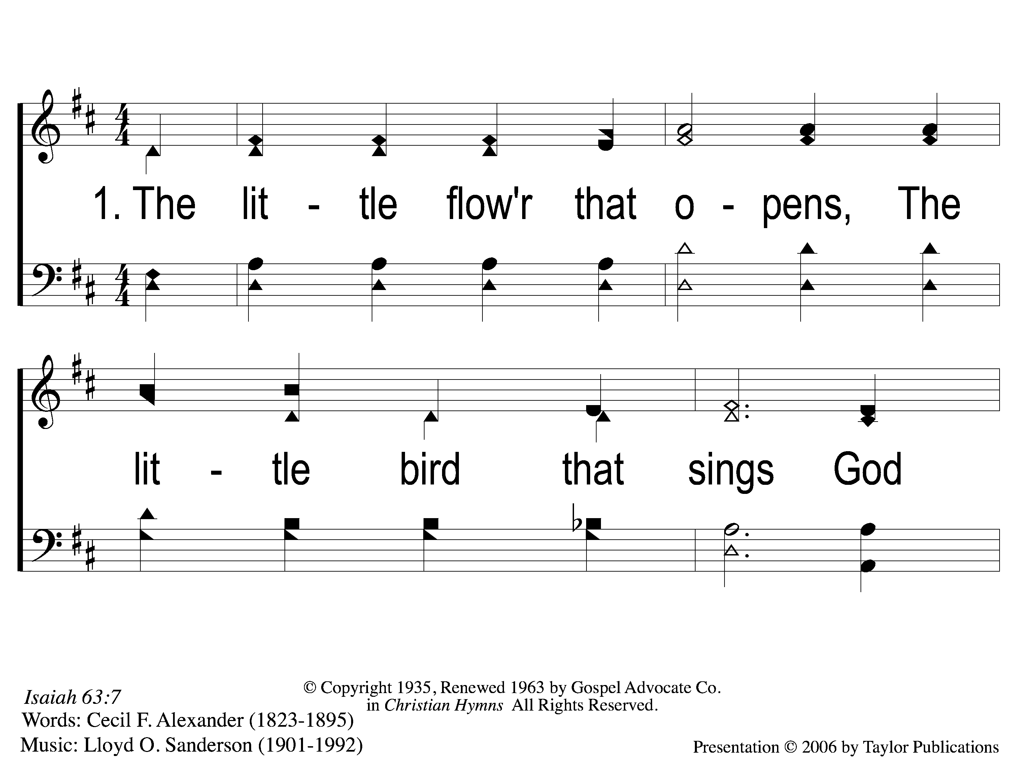
1-1 All Things Bright and Beautiful
All Things Bright and Beautiful
48

Slide 2
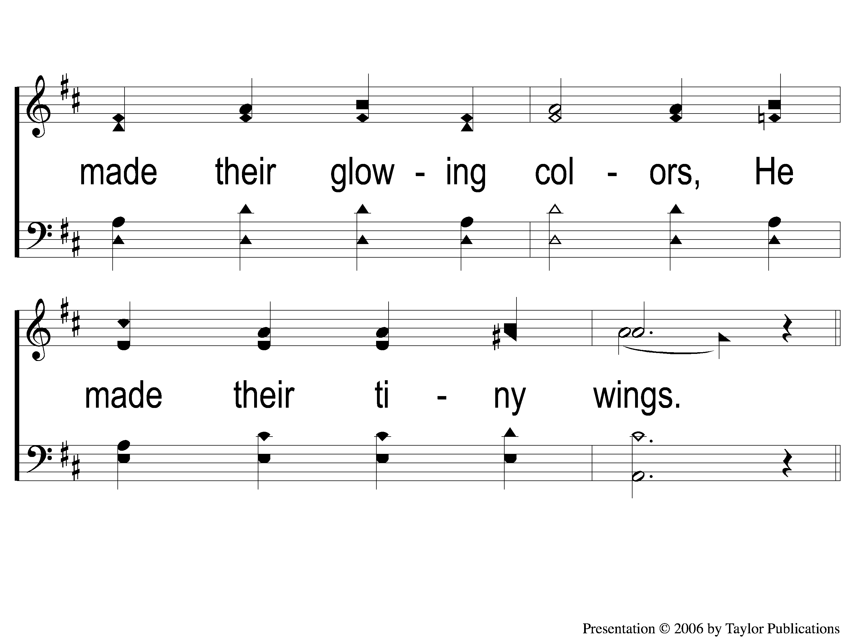
1-2 All Things Bright and Beautiful
All Things Bright and Beautiful
48

Slide 3
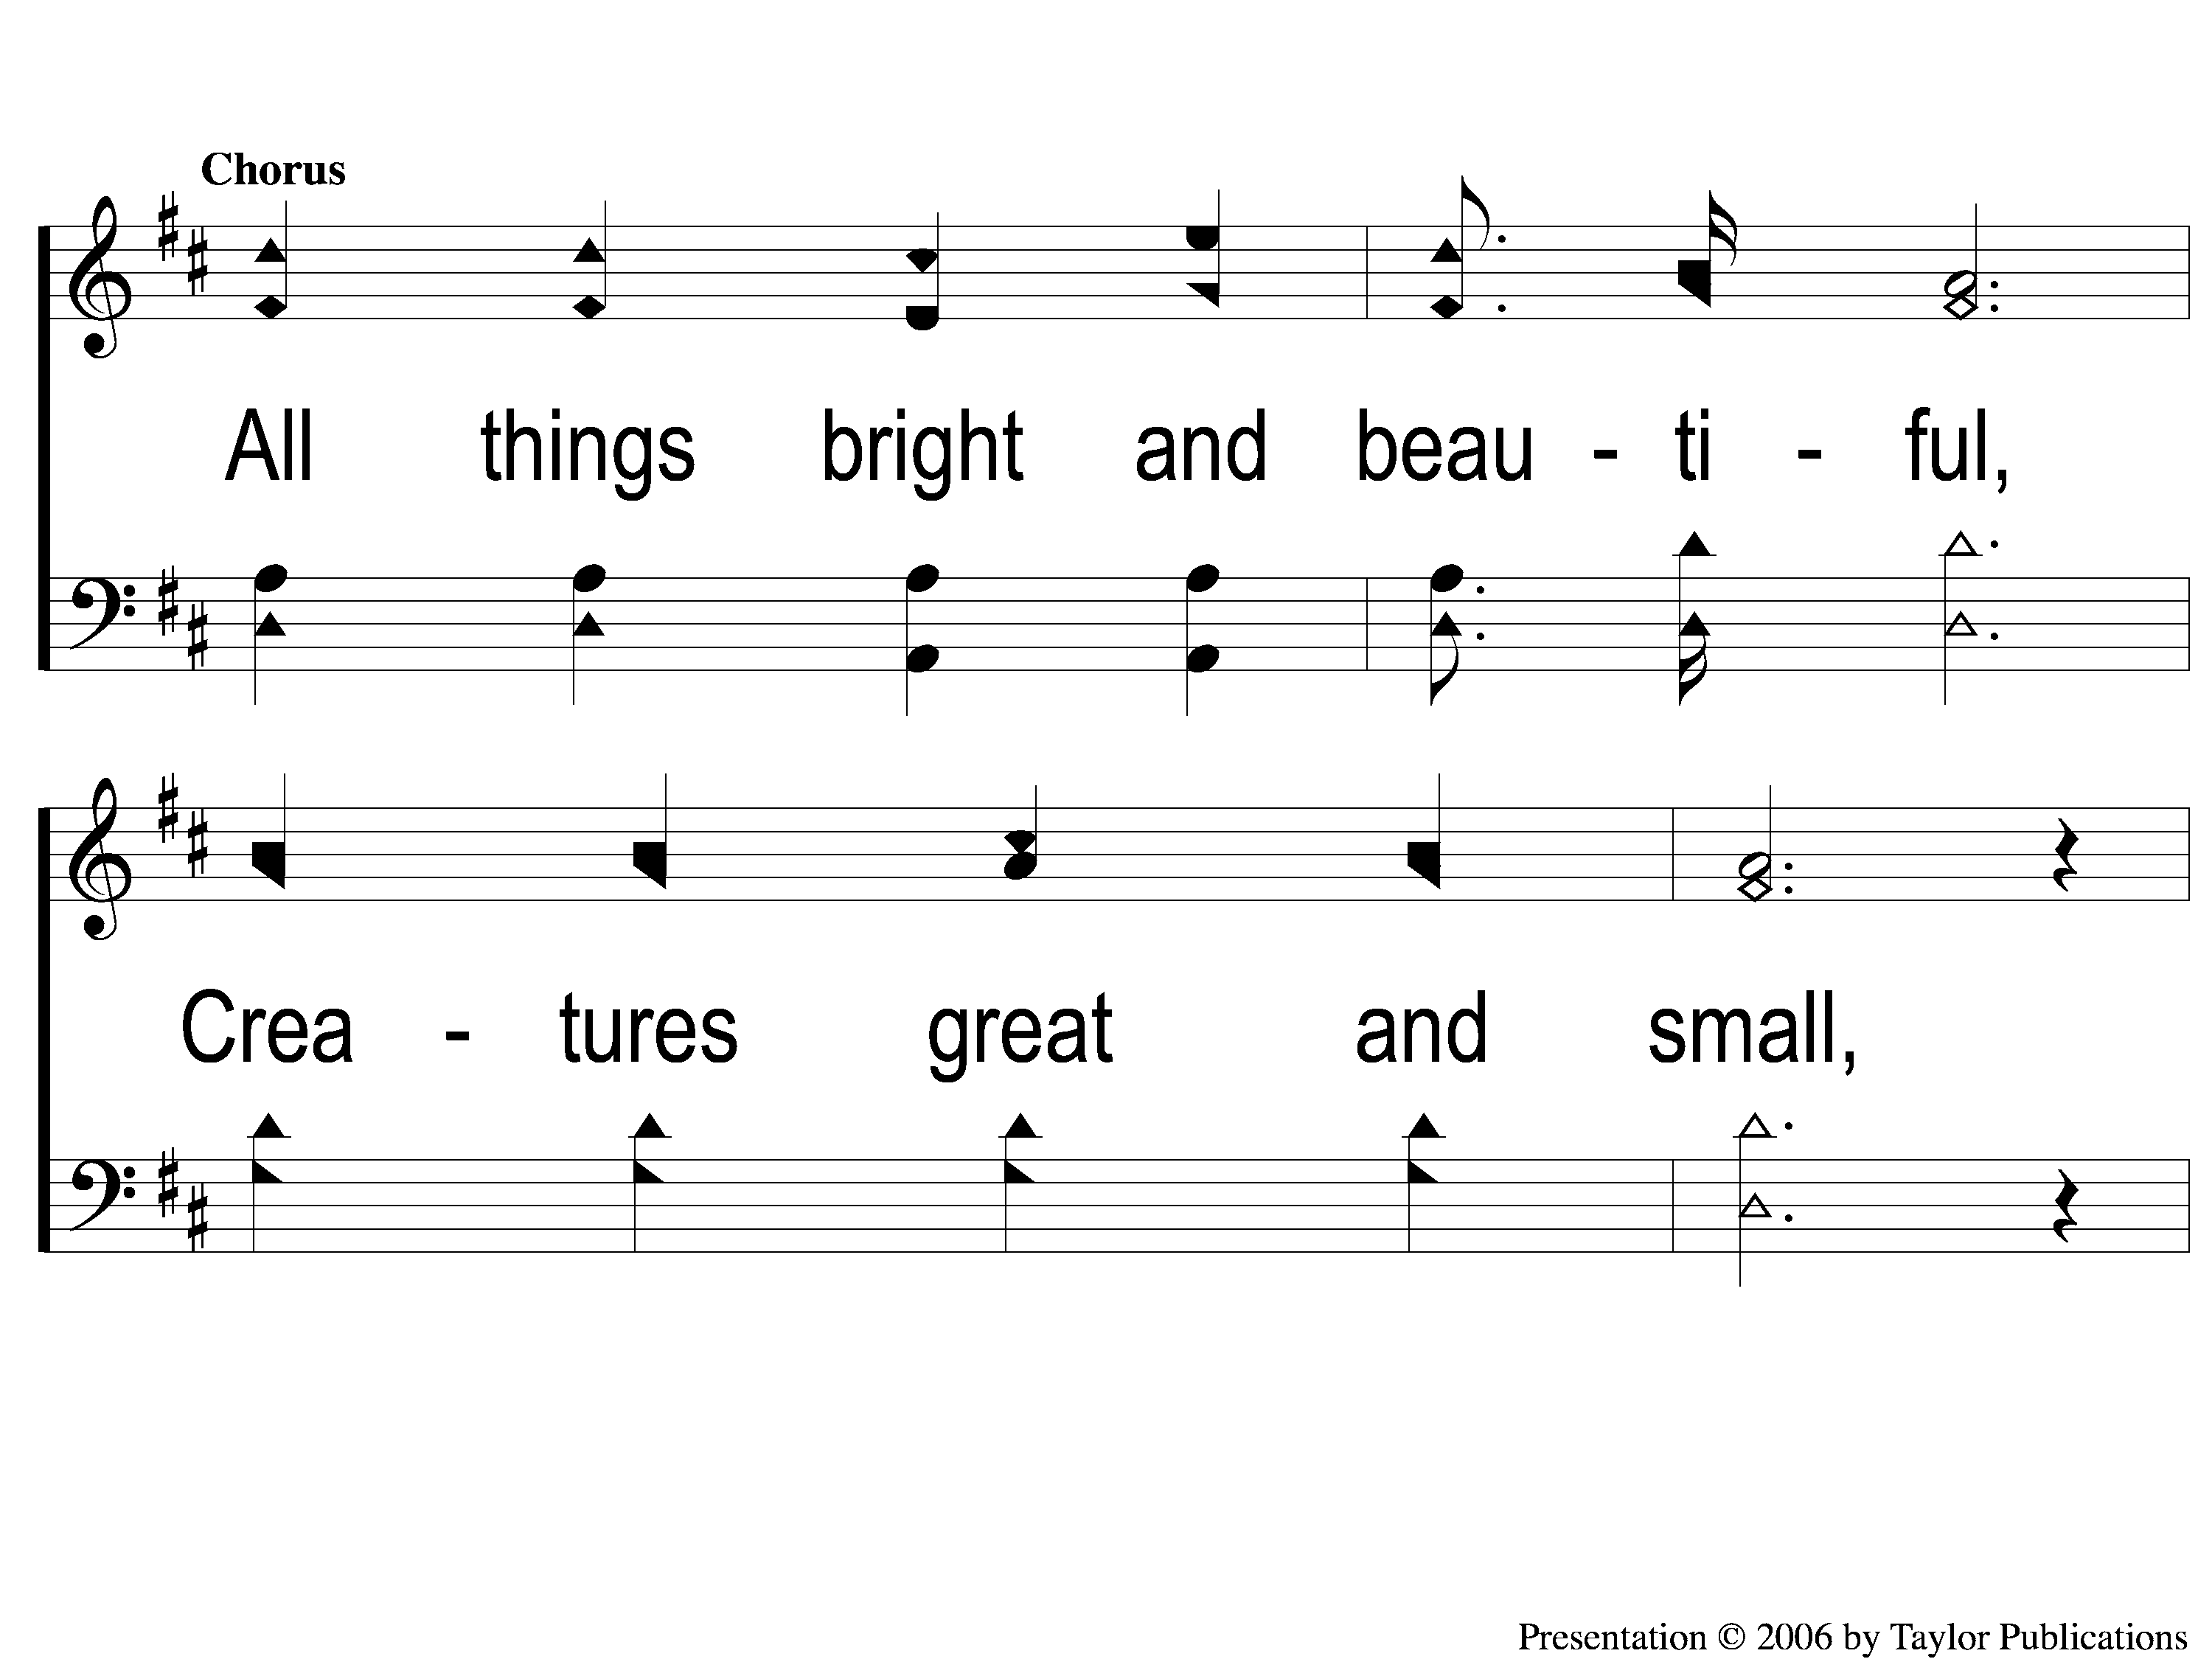
C-1 All Things Bright and Beautiful
All Things Bright and Beautiful
48

Slide 4
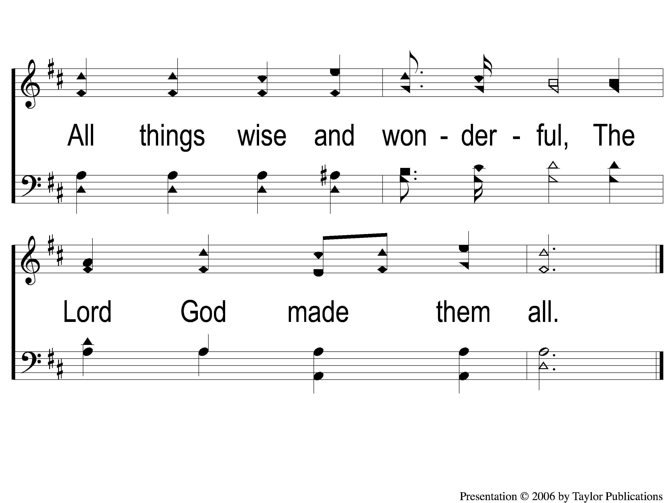
C-2 All Things Bright and Beautiful
All Things Bright and Beautiful
48

Slide 5
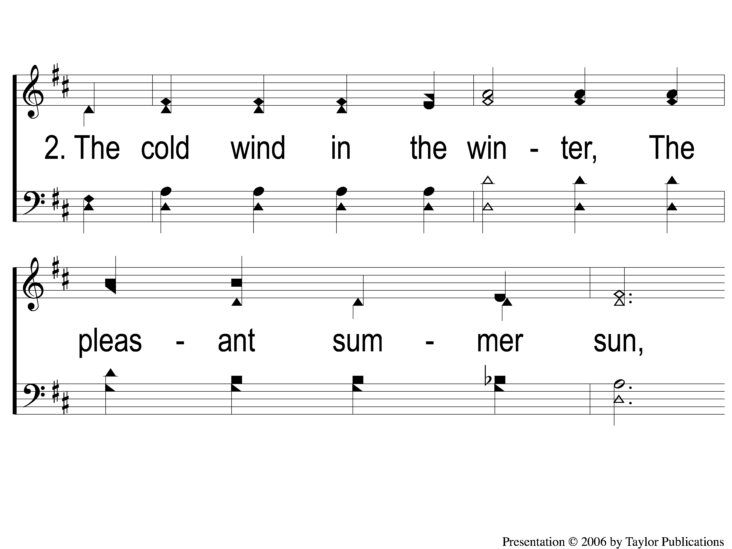
2-1 All Things Bright and Beautiful
All Things Bright and Beautiful
48

Slide 6
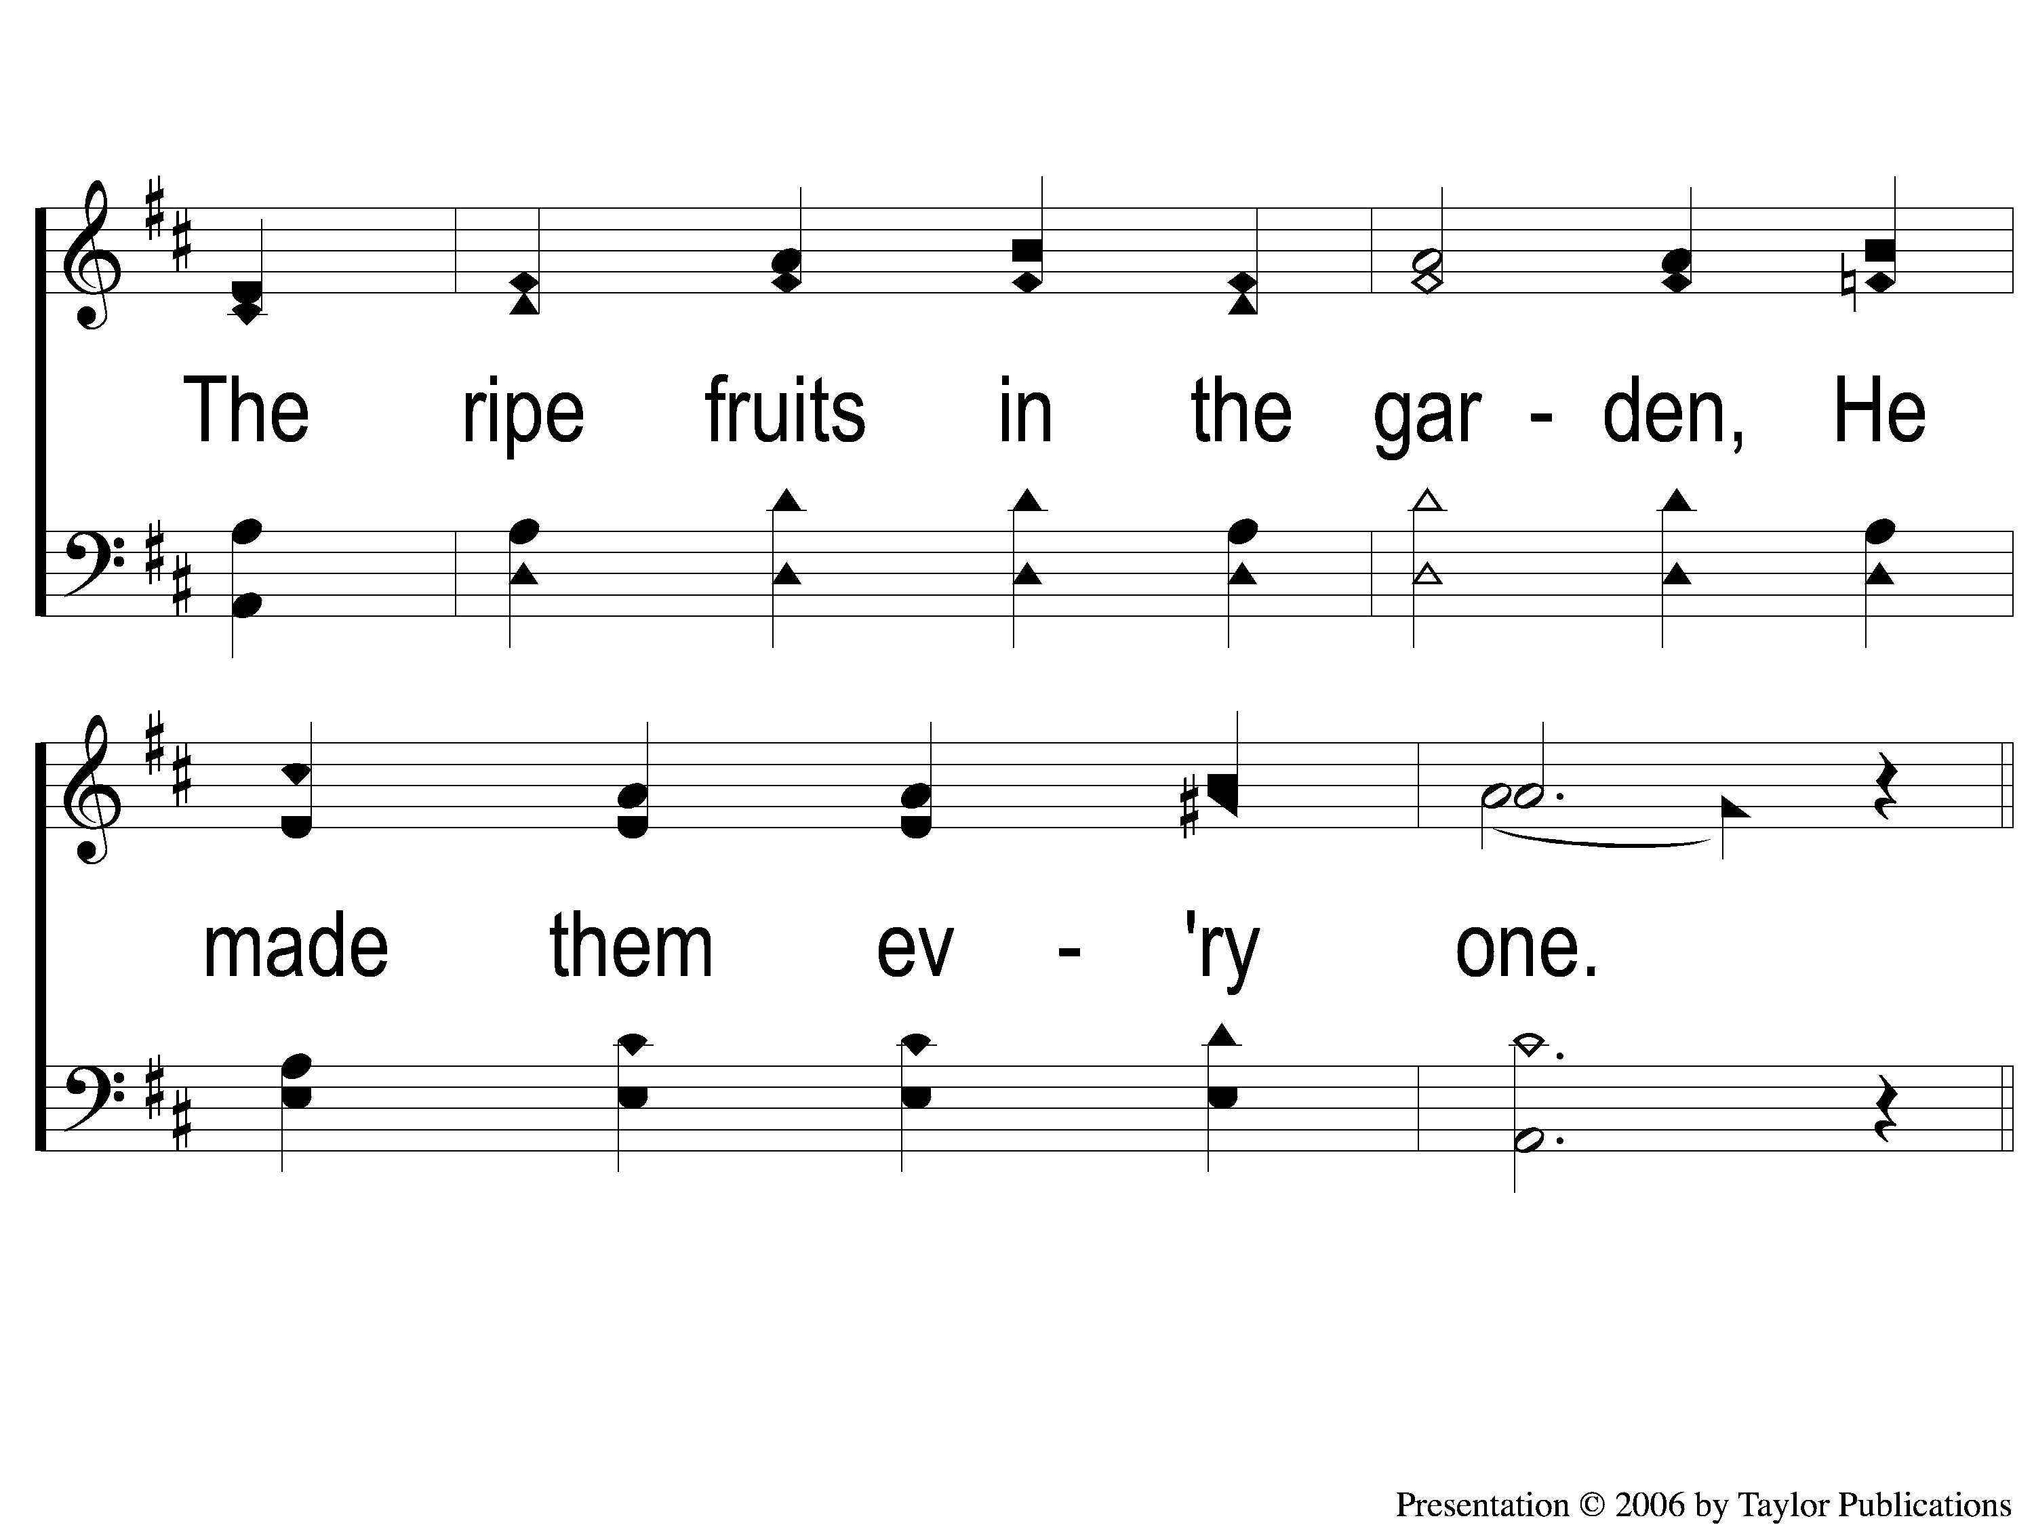
2-2 All Things Bright and Beautiful
All Things Bright and Beautiful
48

Slide 7
C-1 All Things Bright and Beautiful
All Things Bright and Beautiful
48

Slide 8
C-2 All Things Bright and Beautiful
All Things Bright and Beautiful
48

Slide 9
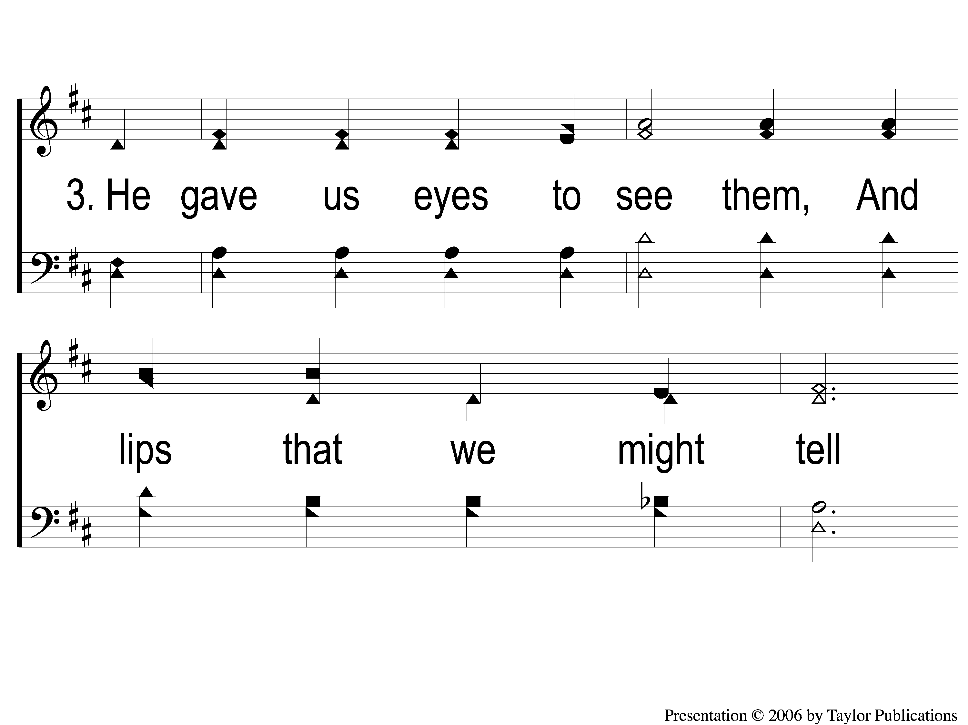
3-1 All Things Bright and Beautiful
All Things Bright and Beautiful
48

Slide 10
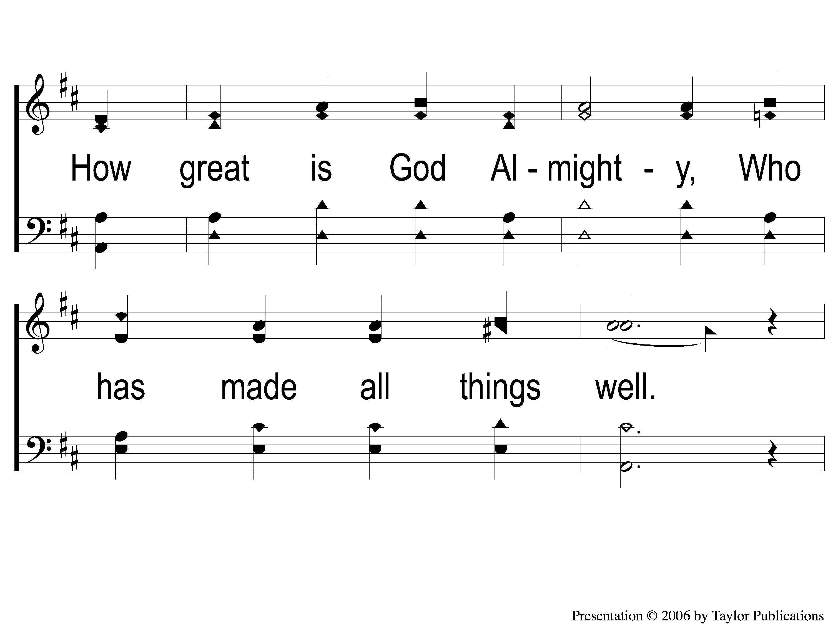
3-2 All Things Bright and Beautiful
All Things Bright and Beautiful
48

Slide 11
C-1 All Things Bright and Beautiful
All Things Bright and Beautiful
48

Slide 12
C-2 All Things Bright and Beautiful
All Things Bright and Beautiful
48

